Slide 1
Talk Title Goes Here
Presenter Name
Presenter Position
Venue
Location
Day, Month 2nd, Year

Slide 2
Title
Software Engineering tools and practice need to evolve to help developers cope with increasing complexity

Slide 3
Full slide Title
My research goal: Design tailored automated approaches to help facilitate developer needs throughout the software engineering lifecycle.

Slide 4
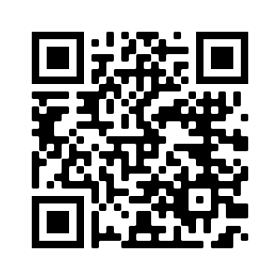
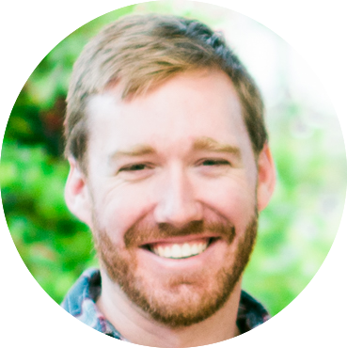
Thank you!
Kevin Moran
Assistant Professor
kpmoran@gmu.edu
https://www.kpmoran.com

